Slide 1
[NAME OF STUDENT]
Memory
Recall
Word
[DATE CREATED]
[NAME OF PRIMARY SCHOOL]

Slide 2
What I’ve accomplished
[NAME OF STUDENT]
(Motivation) Good morning, everyone. My name is [Your Name], and today I'm excited to present my amazing project I've developed using Pygame. The motivation behind this project was to create an interactive and educational game that allows children to practice memorizing words in a fun and engaging way.
(Define Problem) My problem statement is to design a game that encourages children to practice memorizing word before answering, with the aim of fostering an enjoyable learning experience.
(Ideate Approach) To address this challenge, I ideated a concept where images containing a new word image would spawn randomly on the screen. Users, particularly children, would be able to interact with the game by answering, implementing a scoring system to track their progress. The goal was to ensure a child-friendly and engaging gameplay experience.
(Create Solution) Leveraging the Pygame library, I implemented the solution, which consists of a main game loop featuring random images of word, a scoring mechanism, and a defined game over condition. The result is a functional and visually appealing game that aligns with the initial goal of providing an enjoyable learning experience for children.
2
Notes:
Poppins Light – 18 size

Slide 3
[NAME OF STUDENT]
Process Flow
Create an interactive game for children to practice counting shapes that appear in the images, promoting an enjoyable learning experience.
Define Problem
Develop a concept where shapes images shown for children to count.
Implement a scoring system, and introduce visual feedback, ensuring a child-friendly and engaging gameplay.
Ideate Approach
Using Pygame, the solution involves a main game loop with random displaying of shapes images, a scoring mechanism, and a game over condition, providing a functional and visually appealing counting game.
Create
Solution
3
Notes:
Poppins Light – 18 size

Slide 4
[NAME OF STUDENT]
State Flow
Scoreboard
This flowchart shows how the transition between the different states. For instance, after seeing the scoreboard, players can choose to start their game and it will naturally move from ready to question to answer for the player to write an answer. Results will be shown immediately. A final winner screen will show who won the game.
Ready
Question
Answer
Result
Winner
4
Notes:
Poppins Light – 18 size

Slide 5
[NAME OF STUDENT]
Python Concept
Pygame is a set of Python modules designed for writing video games. It provides functionality for creating windows, handling events like key presses, and drawing graphics on the screen.
Pygame
Random library provides functions for generating random numbers. This can be useful for scenarios where randomness is required, such as selecting questions or shuffling elements in a game.
Random
Time.sleep() function causes the program to pause for a specified number of seconds. It's commonly used to introduce delays in code execution, which can be useful in scenarios like creating countdowns or simulating time-based events.
Time.Sleep
5
Notes:
Poppins Light – 18 size

Slide 6
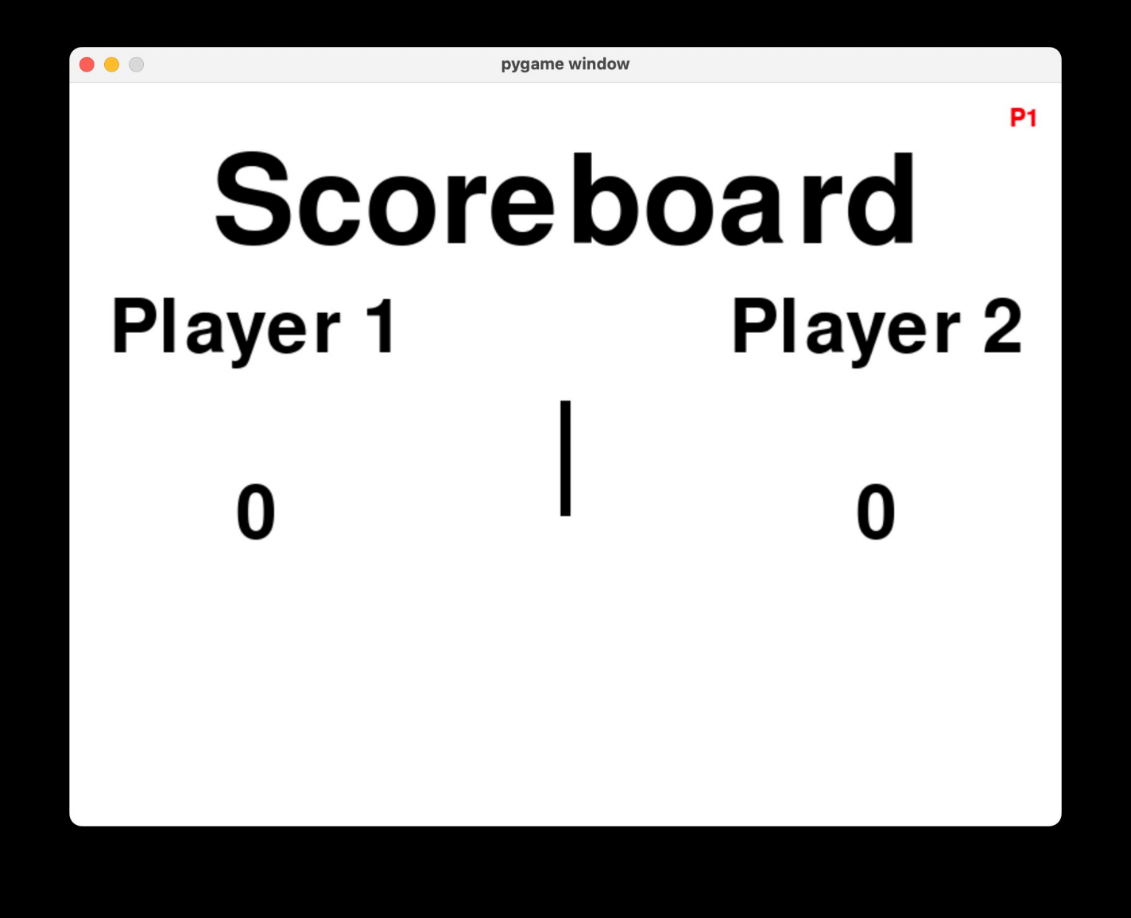
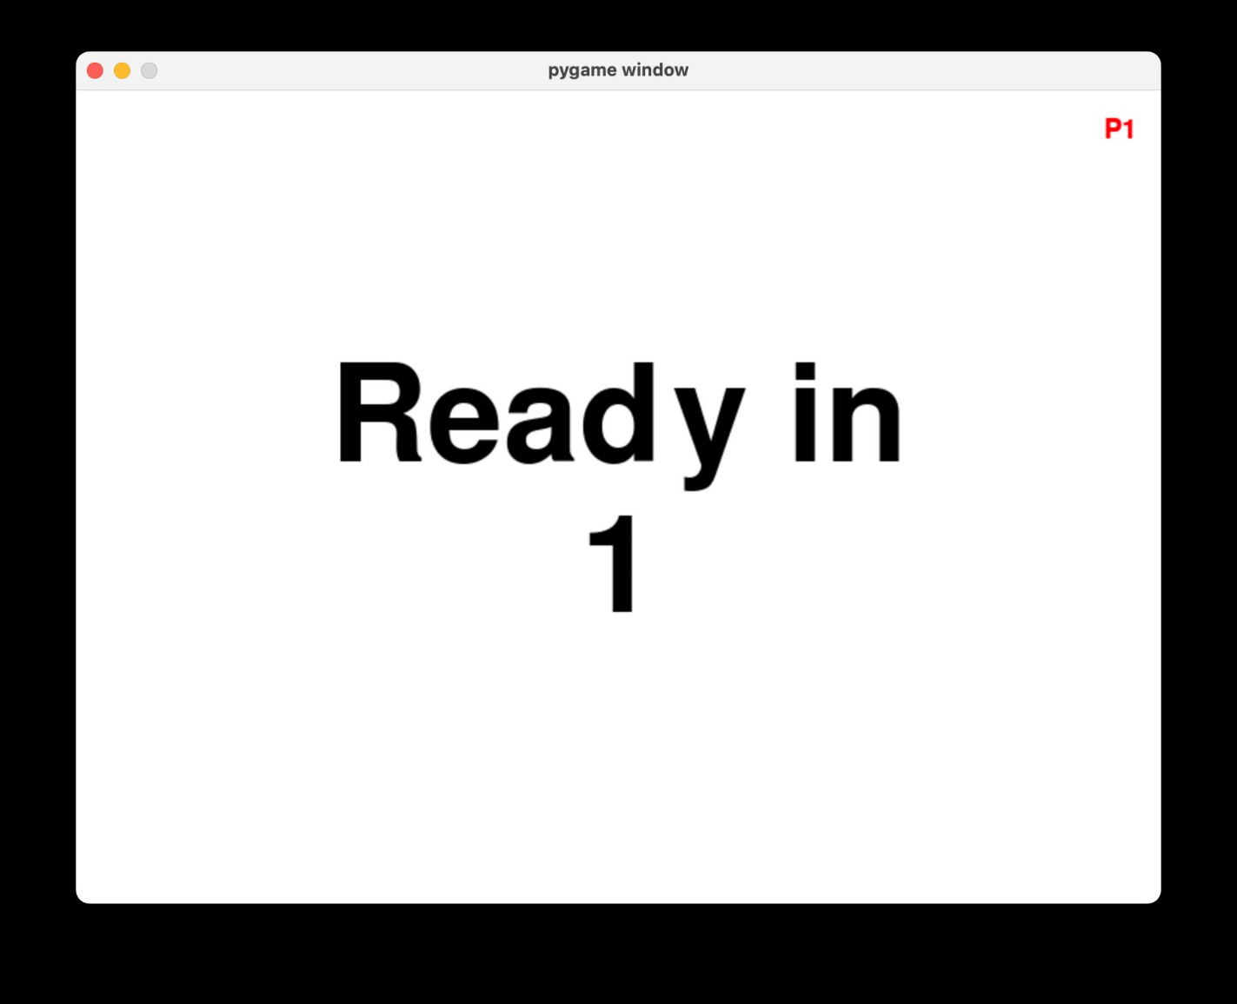
[NAME OF STUDENT]
Mock Screens
Ready In
1
Description
Description
Scoreboard Screen
Ready Screen
6
Notes:
Poppins Light – 18 size

Slide 7
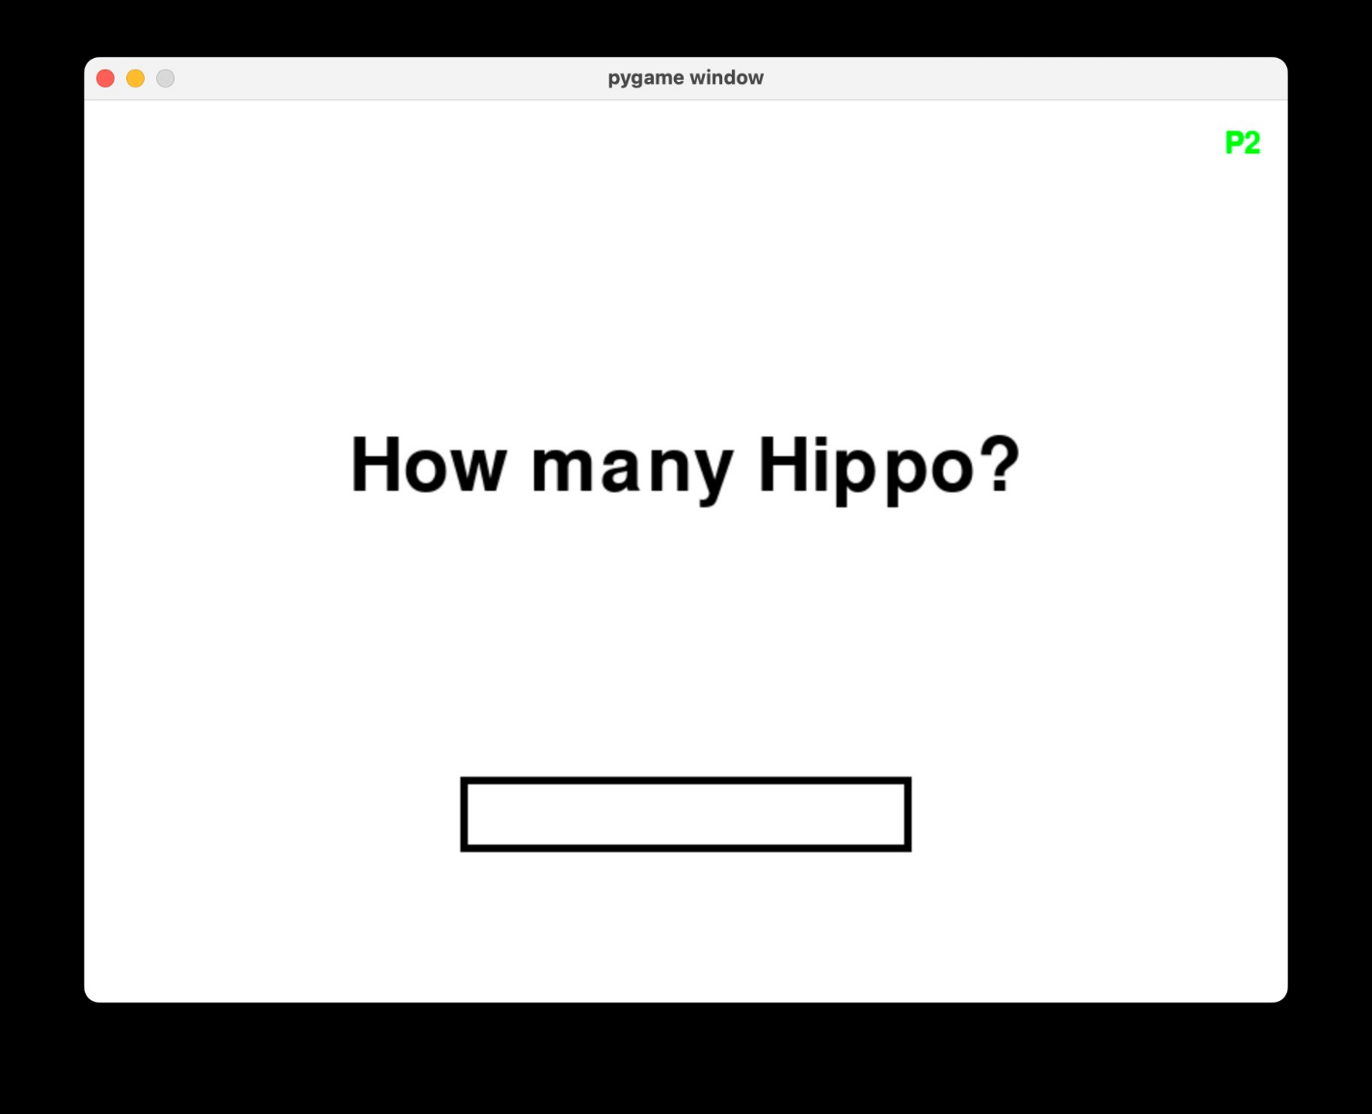
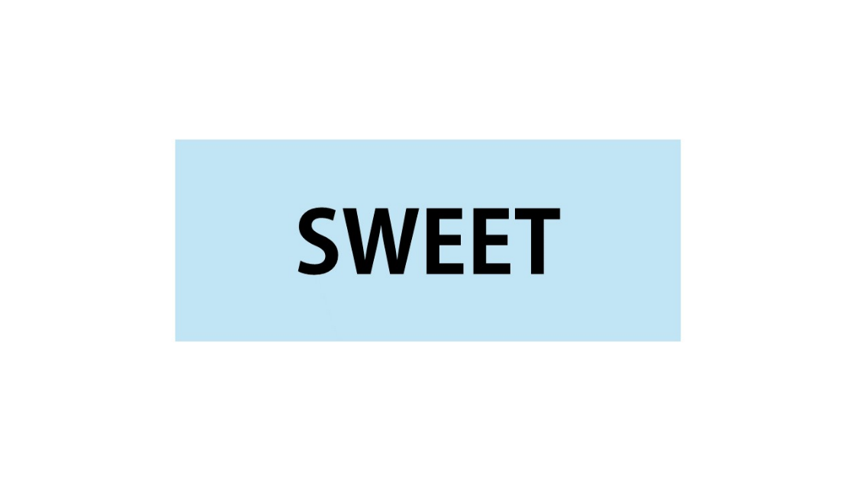
[NAME OF STUDENT]
Mock Screens
What is the word?
Description
Description
Question Screen
Answer Screen
7
Notes:
Poppins Light – 18 size

Slide 8
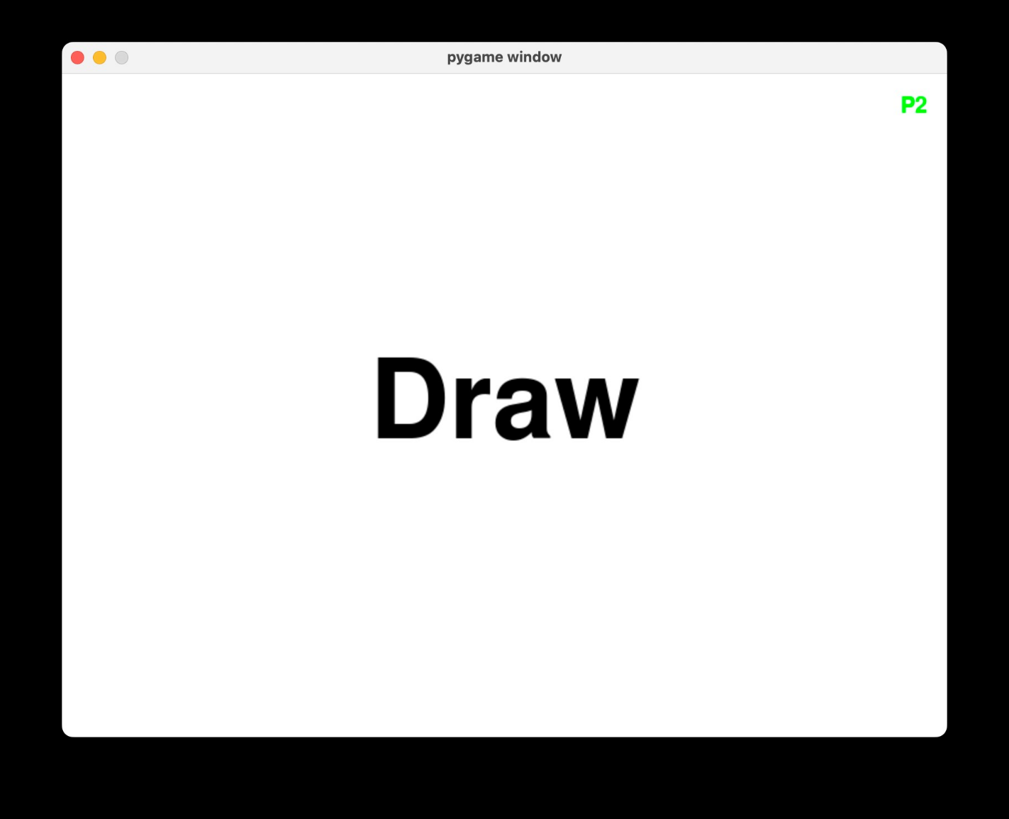
[NAME OF STUDENT]
Mock Screens
You scored 1
Player 1
Wins!
Description
Description
Result Screen
Winner Screen
8
Notes:
Poppins Light – 18 size

Slide 9
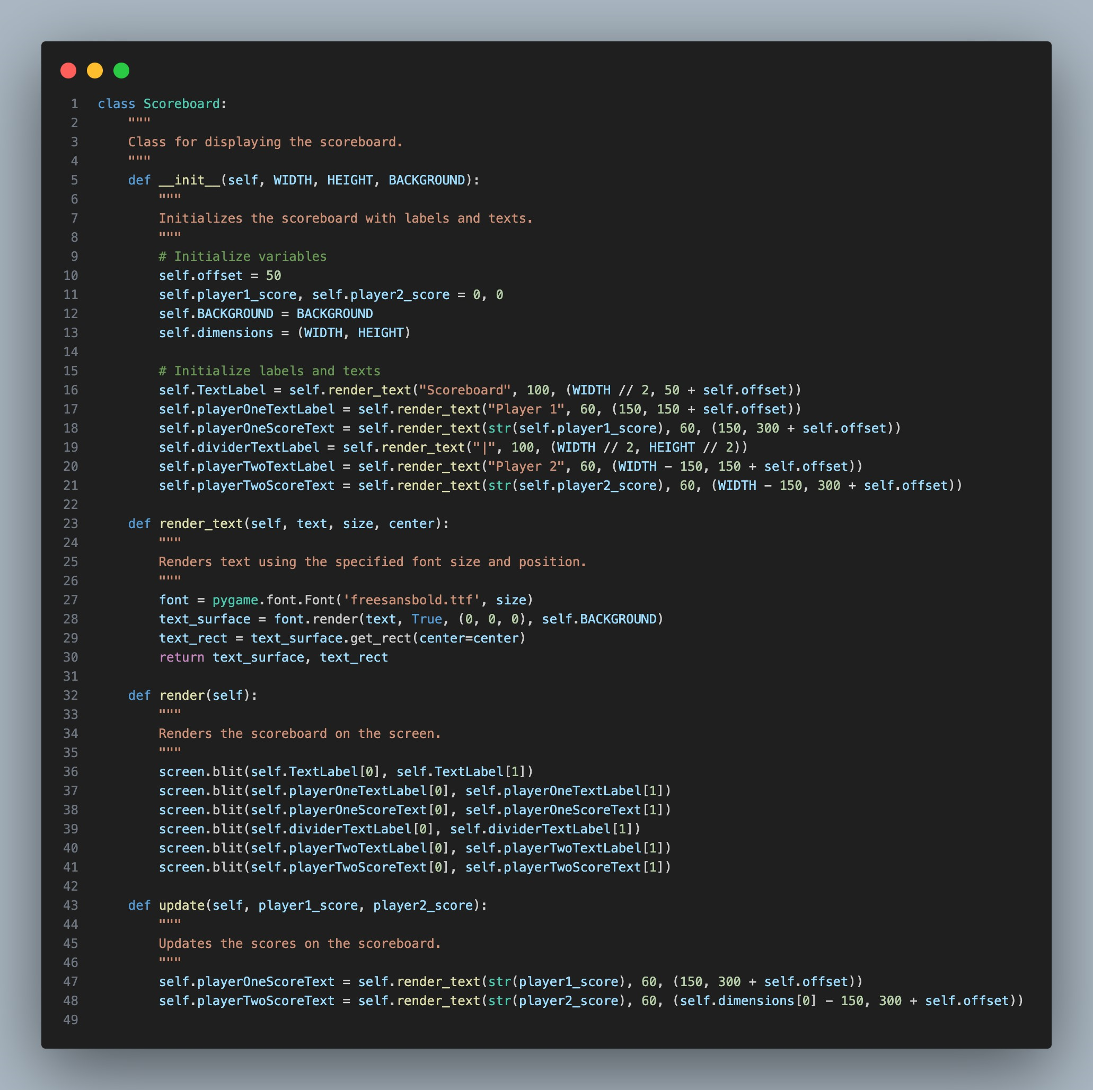
Scoreboard Screen
Displays player scores and labels.
Provides an overview of the current game state.
Elements include player names and their respective scores.
9
Scoreboard Screen
Notes:
Poppins Light – 18 size

Slide 10
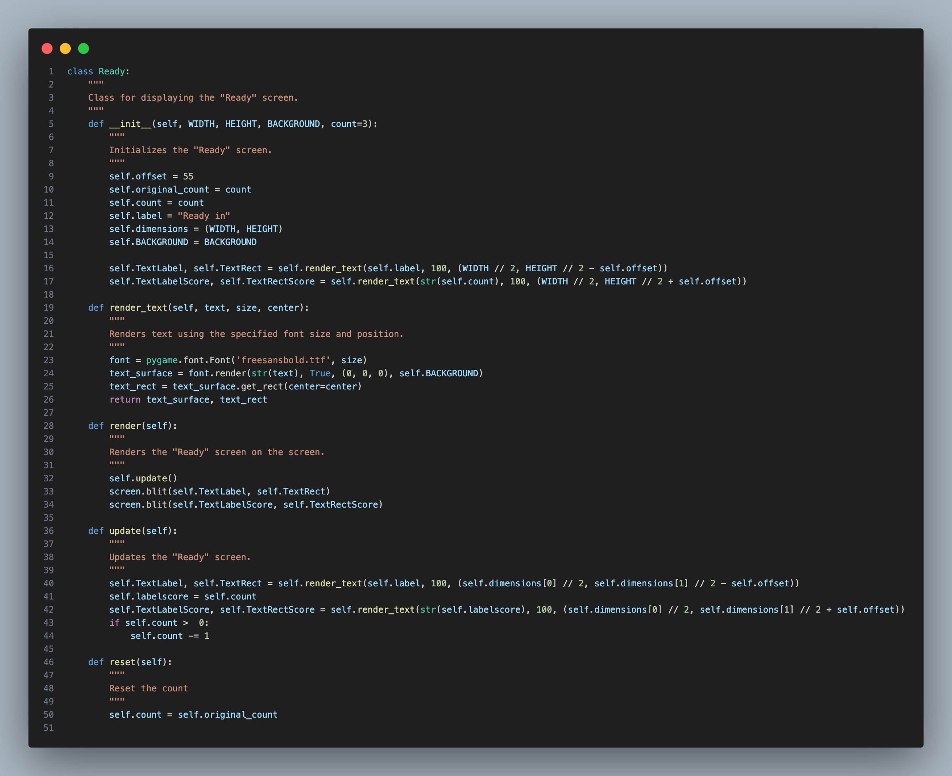
Ready Screen
Counts down to the start of the quiz.
Presents the label "Ready in" and the countdown timer.
Prepares players for the upcoming question.
Ready In
1
10
Ready Screen
Notes:
Poppins Light – 18 size

Slide 11
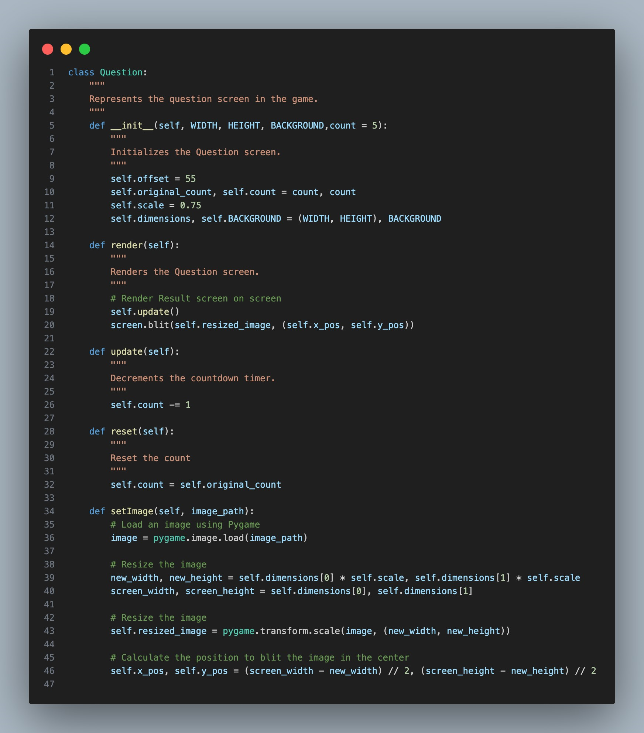
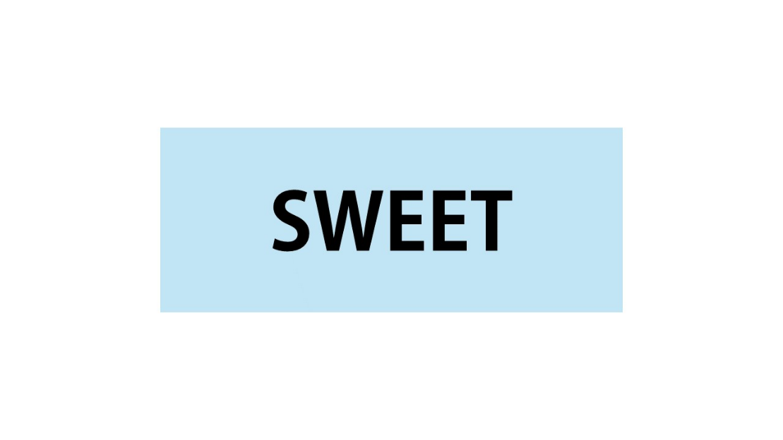
Question Screen
Displays an image related to the question.
Asks a visual question about the image.
Countdown timer indicates remaining time to answer in the background
11
Question Screen
Notes:
Poppins Light – 18 size

Slide 12
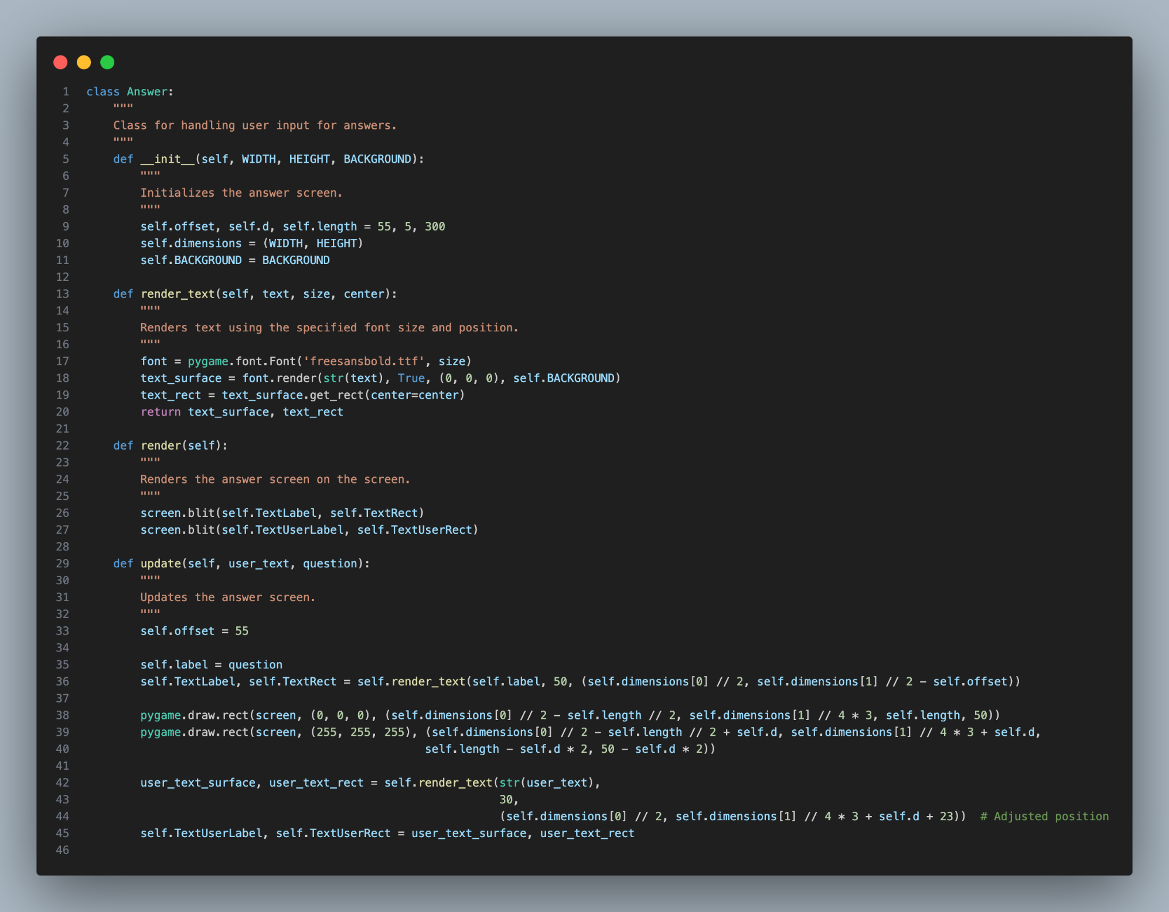
Answer Screen
Allows the player to input their answer.
Displays the label "Enter your answer" and a text input field.
Enables user to type and submit their response.
What is the word?
12
Answer Screen
Notes:
Poppins Light – 18 size

Slide 13
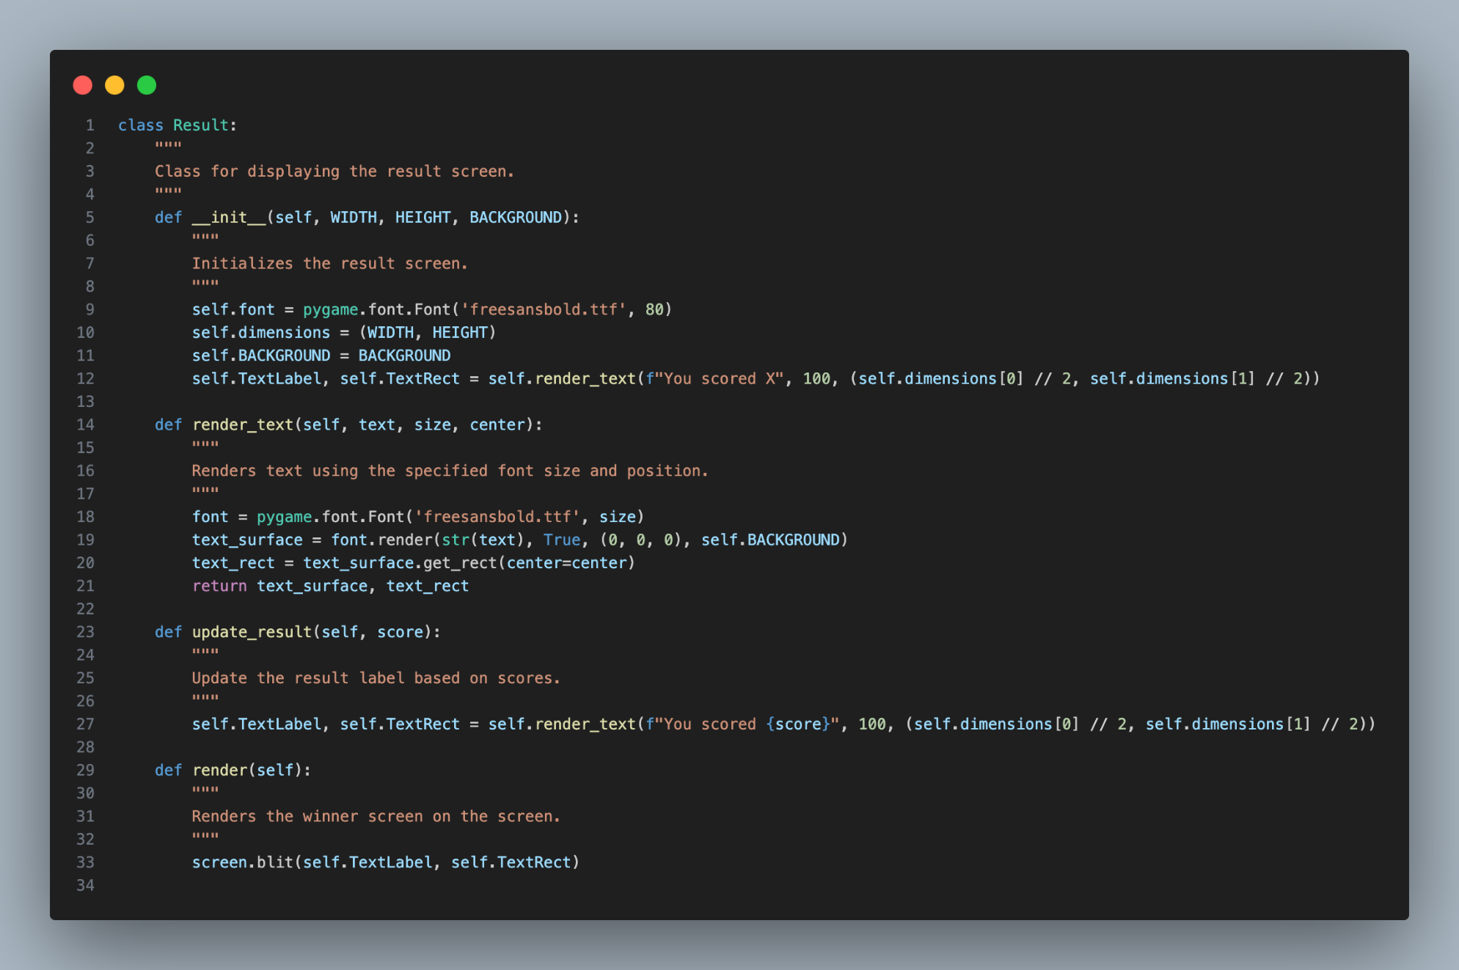
Result Screen
Shows the outcome of the player's answer.
Indicates whether the answer was correct or not.
Presents the label "You scored" and the score.
You scored 1
13
Result Screen
Notes:
Poppins Light – 18 size

Slide 14
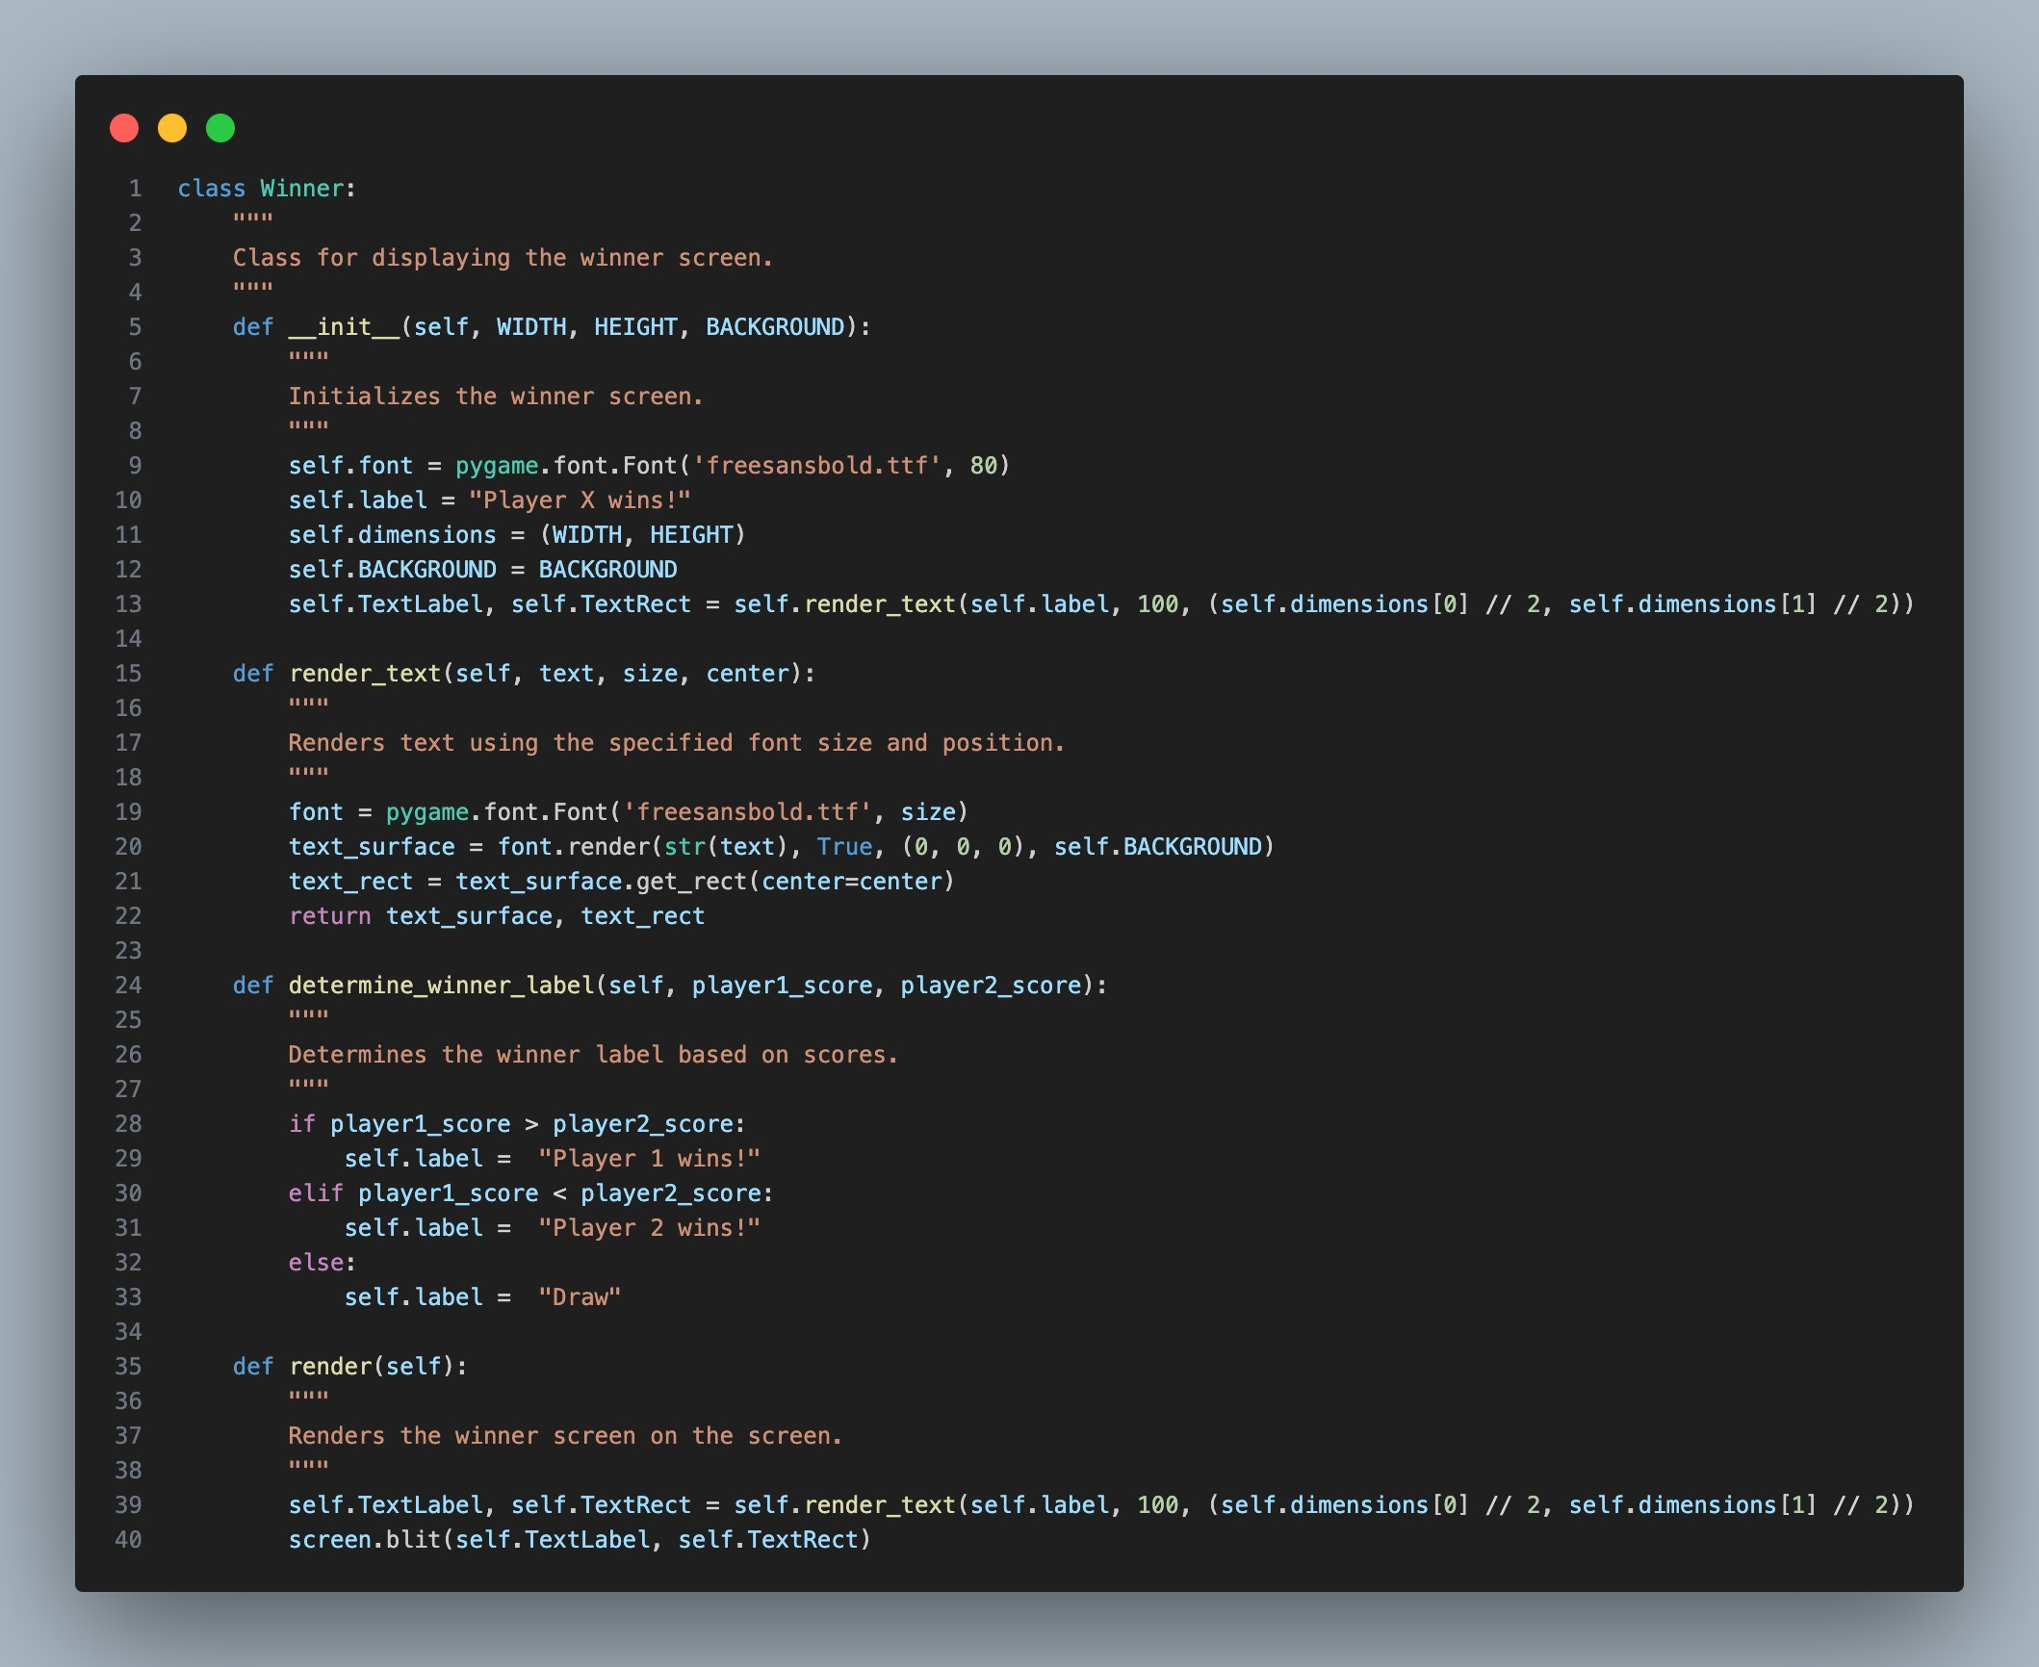
Winner Screen
Declares the winner of the game.
Displays the label "Winner" along with the winning player or a draw message.
Celebrates the victor of the quiz.
Player 1
Wins!
14
Winner Screen
Notes:
Poppins Light – 18 size

